Slide 1
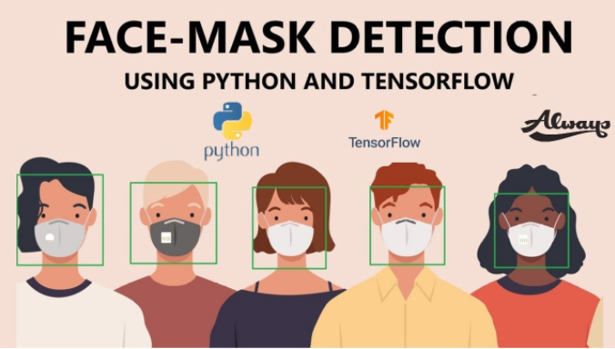

Slide 2
Team members :
H SRINIVASAN (20MIS1078)
M SUGANESHWARAN (20MIS1093)
FATHIMA NOOHU NISHA M (20MIS1147)
Notes:
Team members :

Slide 3
Abstract :
COVID-19 pandemic has rapidly affected our day-to-day life disrupting
the world trade and movements. Wearing a protective face mask has become a new
normal. In the near future, many public service providers will ask the customers to
wear masks correctly to avail of their services. Therefore, face mask detection has
become a crucial task to help global society. This paper presents a simplified
approach to achieve this purpose using some basic Machine Learning packages like
TensorFlow, Keras and OpenCV. The proposed method detects the
face from the image correctly and then identifies if it has a mask on it or not. As a
surveillance task performer, it can also detect a face along with a mask in motion.
The method attains accuracy up to 95.77% and 94.58% respectively on two different datasets.
Notes:
Abstract

Slide 4
Problem statement :
The world has been fighting the pandemic in great spirit, with the
unlocking phases being in motion. This is the time to be more proactive than ever.
Governments all around the world have recognized the power of Artificial Intelligence
and Machine Learning in order to battle the virus.
Since social distancing and wearing a mask are the only monitored ways to
avoid the infection till vaccinations become accessible to all. Computer vision in the
way of Mask Detection is a reviving factor to get our lives back on track. Real Time mask detection can solve the monitoring issues in geographies with high population.
Notes:
p

Slide 5
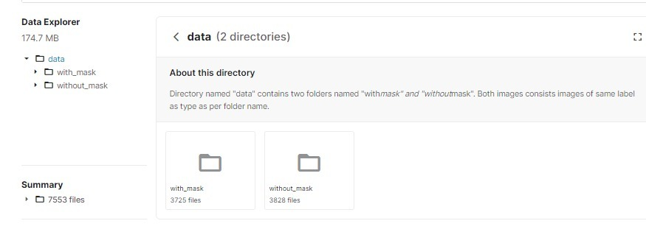
Face Mask Detection Data set :
In recent trend in world wide Lockdowns due to COVID19 outbreak, as Face Mask is became mandatory for everyone while roaming outside, approach of Deep Learning for Detecting Faces With and Without mask were a good trendy practice. Here I have created a model that detects face mask trained on 7553 images with 3 color channels (RGB).On Custom CNN architecture Model training accuracy reached 94% and Validation accuracy 96%.
Link: https://www.kaggle.com/omkargurav/face-mask-dataset?select=data

Slide 6
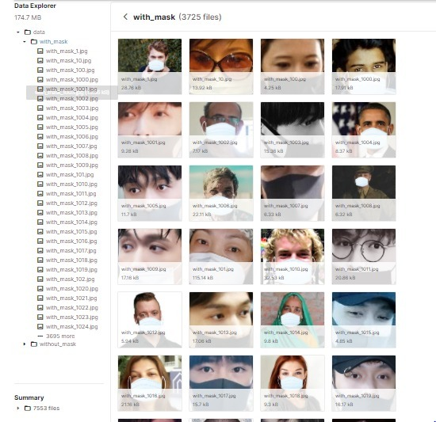
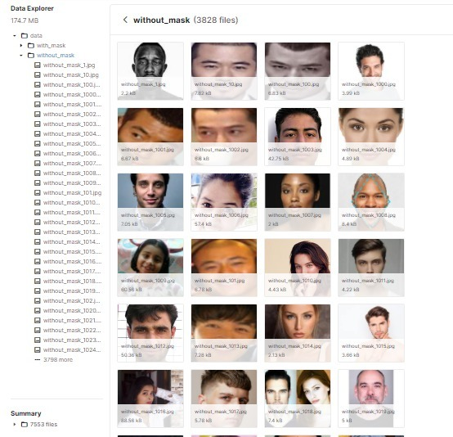

Slide 7
Packages to be used :
OpenCV
Keras
TensorFlow

Slide 8
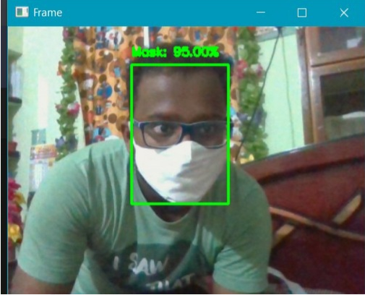
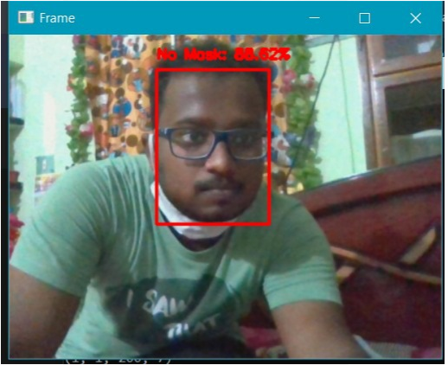
Expected output :
Notes:
Expected output :

